Slide 1
Design & Implement Community Portal Database
Module Project
Module: Database Design and Implementation
Course: NICF-Advanced Certificate in Infocomm Technology (Software & Applications)
Start Date : 15 Feb 2022
End Date : 12 March 2022
Submission Date : 12 March 2022
Learner Name : Joshua Ho Gwok Hin
Enrollment ID :
Presentation Date : 14 March 2022

Slide 2
Contents
Document History
Version Number | Effective Date of release | Summary of Included Changes | Author
1 | 4th March 2016 | First Edition | Satya CVS
4 | 26th July 2017 | Changed for Module 4 | Shrinivas K R
5 | 5th June 2018 | Changed for Module 4 RQF | Shrinivas K R

Slide 3
Contents
Contents
S. No. | Description
01 | Development Tools
02 | Database Requirements
03 | Entities
04 | Conceptual Design
05 | Logical Design
06 | Tables
07 | Fields
08 | Primary Key, Foreign Key & Indexes
09 | SQL Queries
10 | Report Queries
11 | Indexes
12 | Backup Script
13 | Project Milestones & Tasks

Slide 4
Contents
Contents
S. No. | Description
17 | Milestone Feedback & Action taken
18 | Modifications Made based On Feedback
19 | Project Results
20 | Proposed Improvements

Slide 5
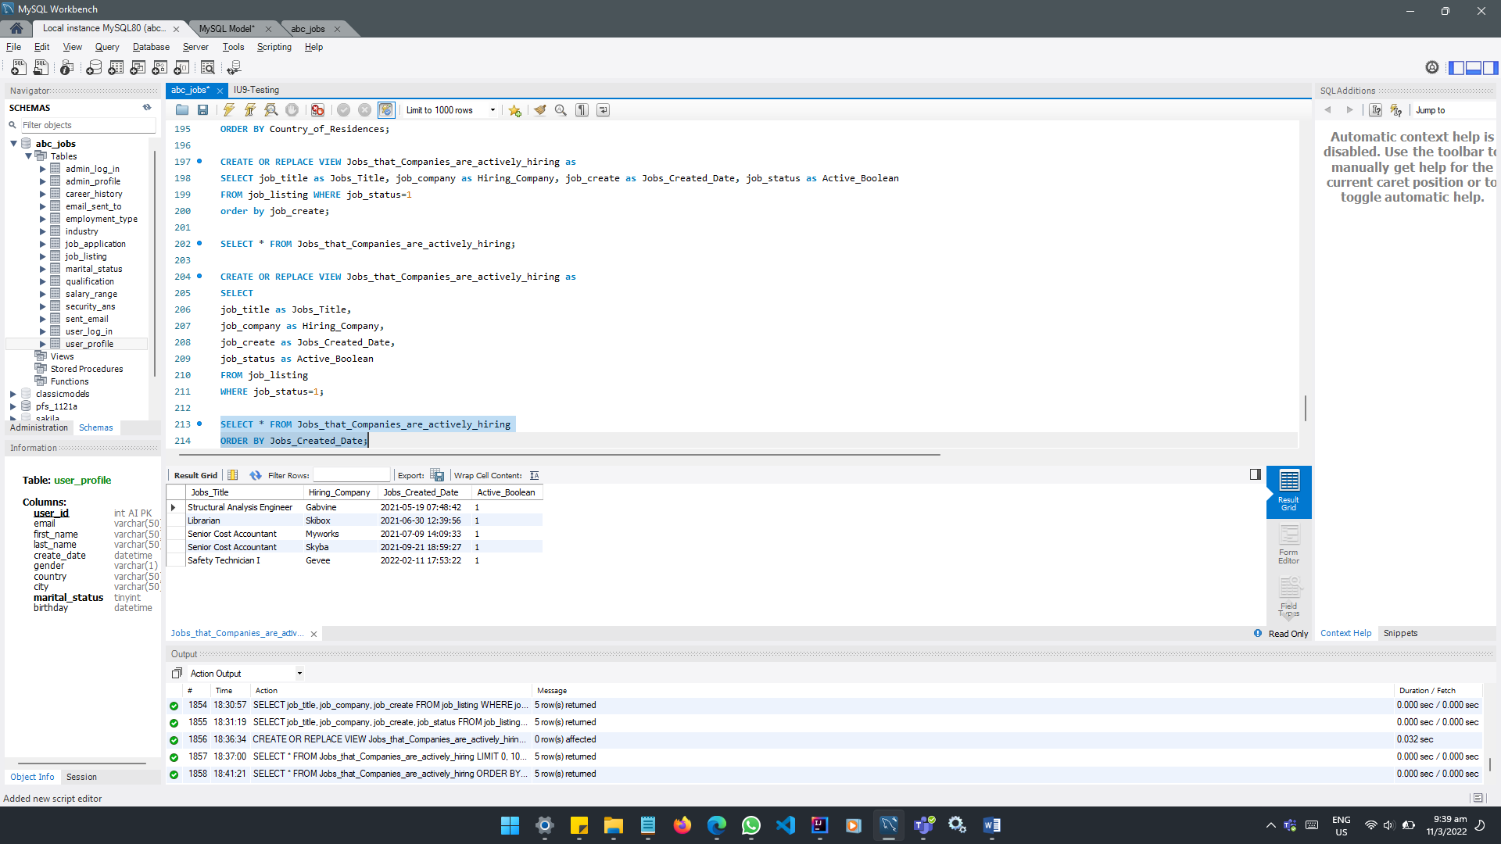
1. Development Tools
Development Tools Screen captures
MySQL Workbench 8.0 CE

Slide 6
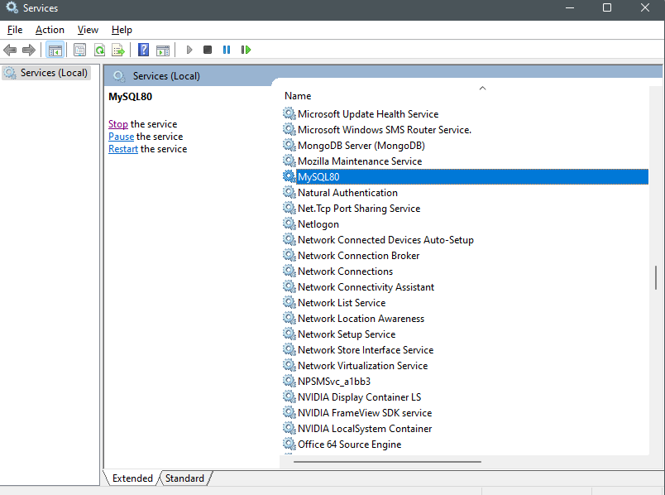
1. Development Tools
Development Tools Screen captures
MySQL Server 8.0

Slide 7
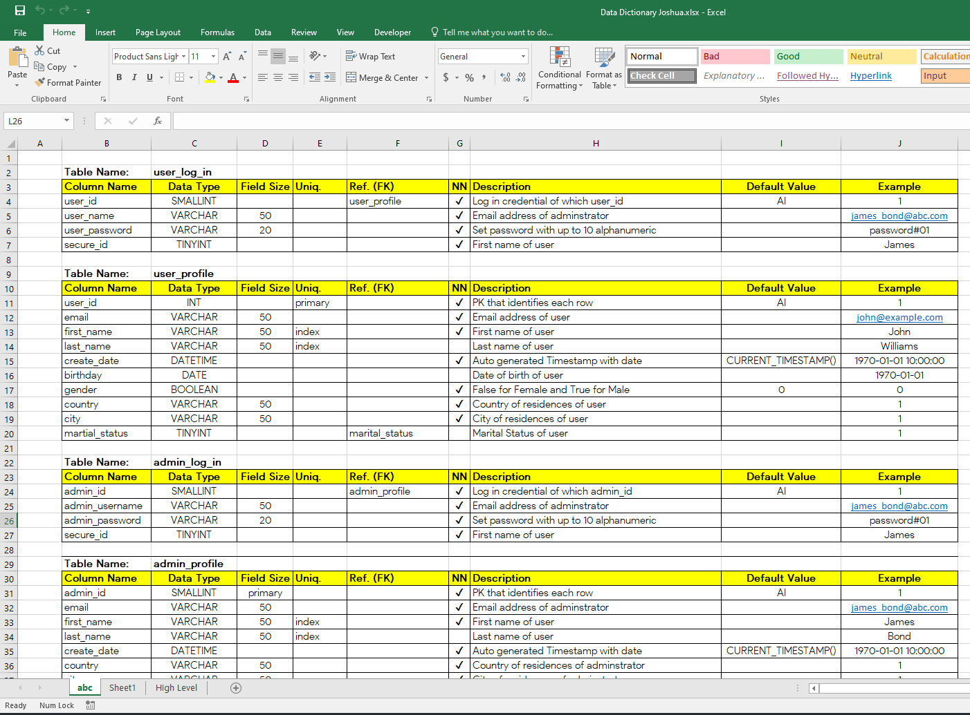
1. Development Tools
Development Tools Screen captures
MS Excel

Slide 8
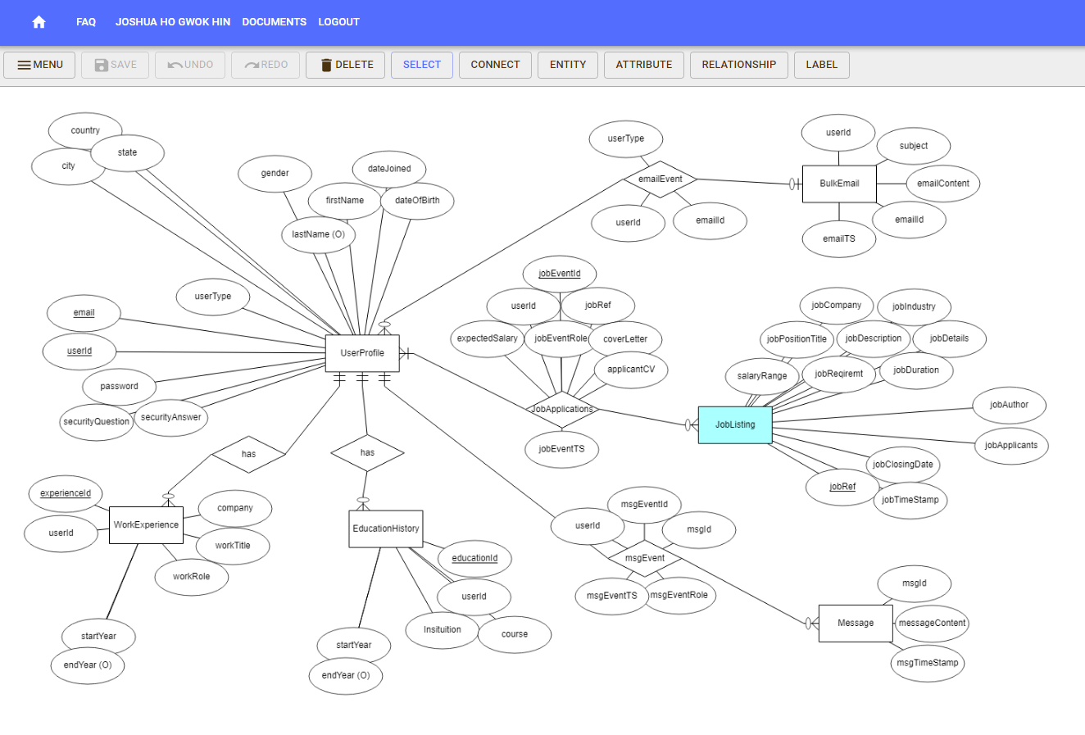
1. Development Tools
Development Tools Screen captures
ERDPlus.com

Slide 9
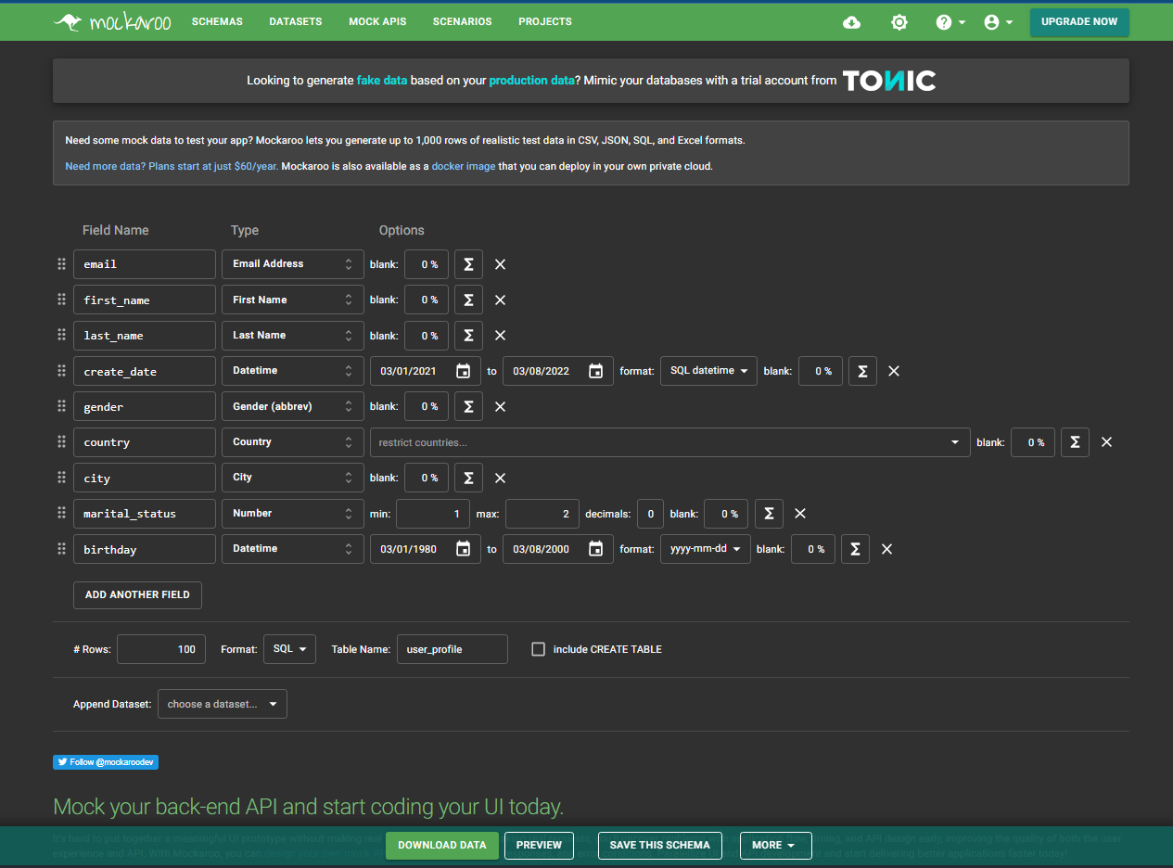
1. Development Tools
Development Tools Screen captures
Mockaroo.com

Slide 10
2. Database Requirements
ABC Jobs Pte Ltd is looking for a database design solution for their community jobs portal. This community portal will have two main groups of users, namely the software engineers and web-app administrators. The design of this database has to be in tandem with the business needs and goals of ABC Jobs Community Portal.
The main objectives of this project is to plan, design, build and validate that the database is capable of handling operations that may be performed by target user groups and management.
The two main groups of target users are software engineers and web-app administrators. The overall design of the database allows functional manipulation of records for target users and the management. Functions such as updating personal particulars, posting a job listing, applying for jobs, searching & connecting with other users, and bulk email are put into consideration in the planning phase of the database design.
The planning of database can somewhat be represented by an Entity Relationship Diagram and Data Dictionary.
Next, entities and attributes in the ERD are then converted/translated into database/schema tables and columns respectively using MySQL Workbench.
Mock data generated with Mockaroo.com were then imported to some tables to simulate a working model. This can help identify some relationship errors that may present during the design & implementation stage.
An automated backup were also included.

Slide 11
3. Entities
No | Entities | Entity Description | Functions/Pages
1 | admin_profile | Contains general information of administrators. | Admin Home Page
2 | admin_log_in | Administrator log in credentials | Admin Log in Page
3 | user_profile | Contains private and public information of unique users indexed by user_id. Example: First, Last, User Names, log in details, Job title & description, Work, education, award history, demographical classification in age, gender, location. | Login Page Registration Page, Confirmation Common Header Common User Dashboard Profile Page Update Profile, Confirmation Search user(s) page Home Page (Common user) Home Page (Administrators) All other pages with common header and user dashboard.

Slide 12
3. Entities
4 | user_log_in | User log in credentials | Log in Page Registration Page, Confirmation Update Profile, Confirmation Forget Password Reset Password
5 | career_history | Records of Employment History | Profile Page Search user(s) page
6 | qualification | Records of Education | Profile Page Search user(s) page
7 | job_listing | Master Table for job listings where actual job title, details, requirements are. | Search Job page Search Job listings Job application page, Confirmation Create Job page, Confirmation
8 | job_application | Transactional Table to record job authorship and candidate applications. Events recorded with time stamp. | Job application page, Confirmation Create Job page, Confirmation
9 | security_ans | Security Answer for changing password | Forget Password page
10 | marital_status | Marital Status of users. | Profile page

Slide 13
3. Entities
11 | industry | Industry of Job Listings | Job Listing page Job application page Search job list
12 | salary range | Expected salary of Job Listings | Job Listing page Job application page Search job list
13 | employment_type | Type of employment Temp, Contract, Full Time, and etc. | Job Listing page Job application page Search job list
14 | sent_email | Content and subject of sent email | Admin home page
15 | email_sent_to | Identify the intended recipients of bulk email | Email success page

Slide 14
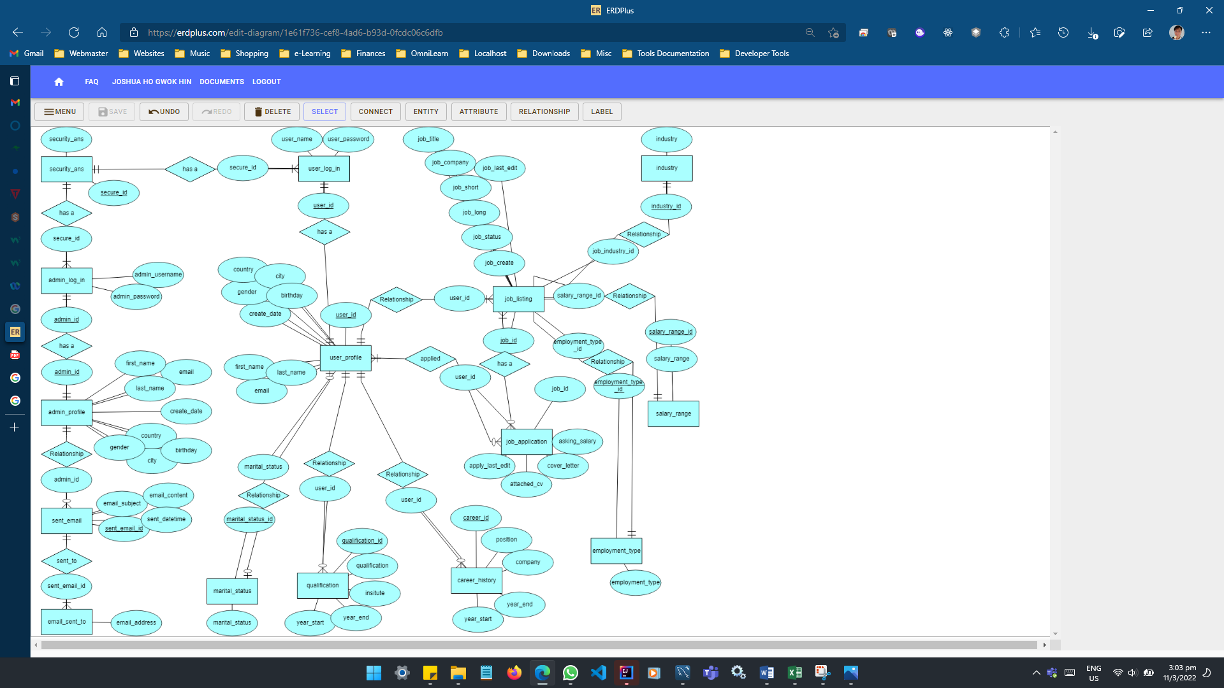
4. Conceptual Design

Slide 15
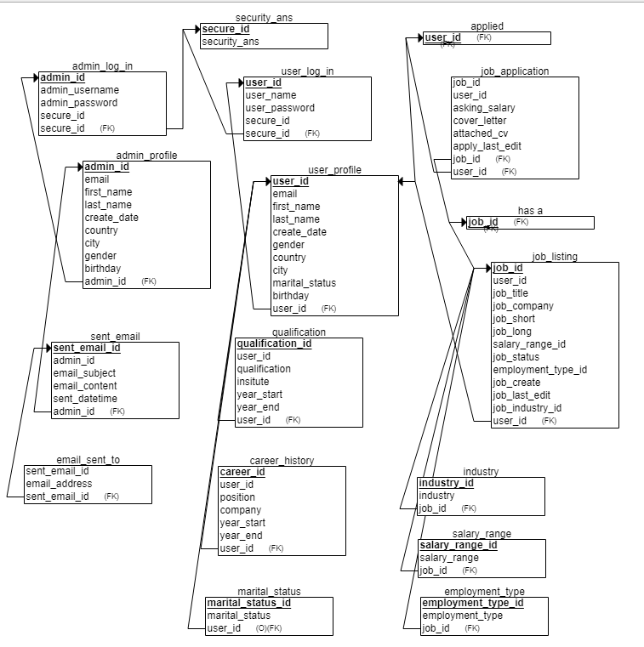
5. Logical Design

Slide 16
5. Logical Design
RELATIONSHIP TABLE
S/N | Table | Primary Key | Reference Table | Foreign Key
1 | admin_log_in | admin_id | admin_profile security_ans | admin_id secure_id
2 | admin_profile | admin_id
3 | career_history | career_id | user_profile | user_id
4 | email_sent_to |  | sent_email | sent_email_id
5 | employment_type | employment_type_id
6 | industry | industry_id
7 | job_application | job_id user_id | job_listing user_profile | job_id user_id
8 | job_listing | job_id | user_profile industry salary_range employment_type | user_id industy_id salary_range_id employment_type_id
9 | marital_status | marital_status_id
10 | qualification | qualification_id | user_profile | user_id
11 | salary_range | salary_range_id
12 | sent_email | sent_email_id | admin_profile | admin_id
13 | user_log_in | user_id | user_profile security_ans | user_id secure_id
14 | security_ans | secure_id
15 | user_profile | user_id | marital_status | marital_status_id

Slide 17
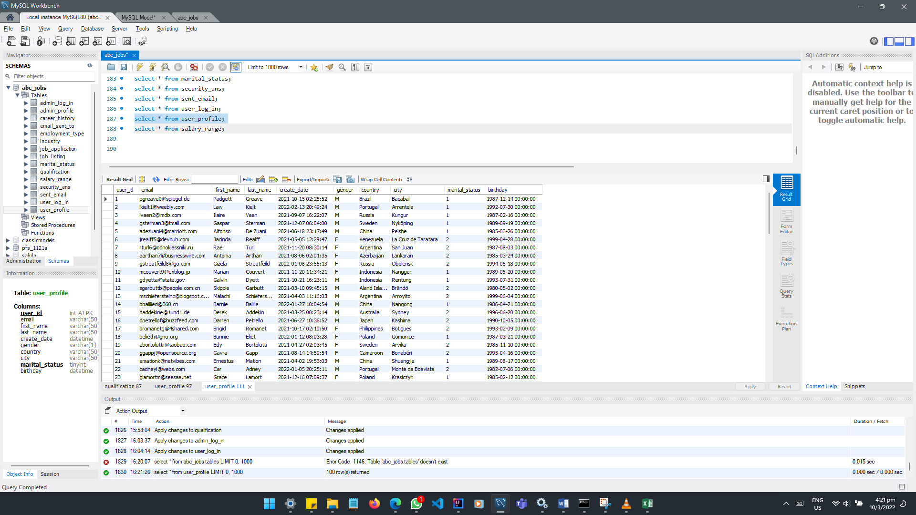
6. Tables

Slide 18
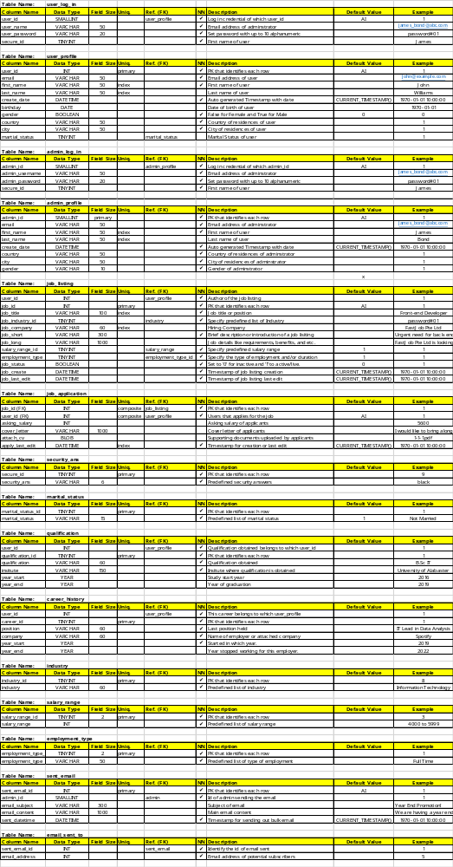
7. Fields

Slide 19
7. Fields

Slide 20
7. Fields

Slide 21
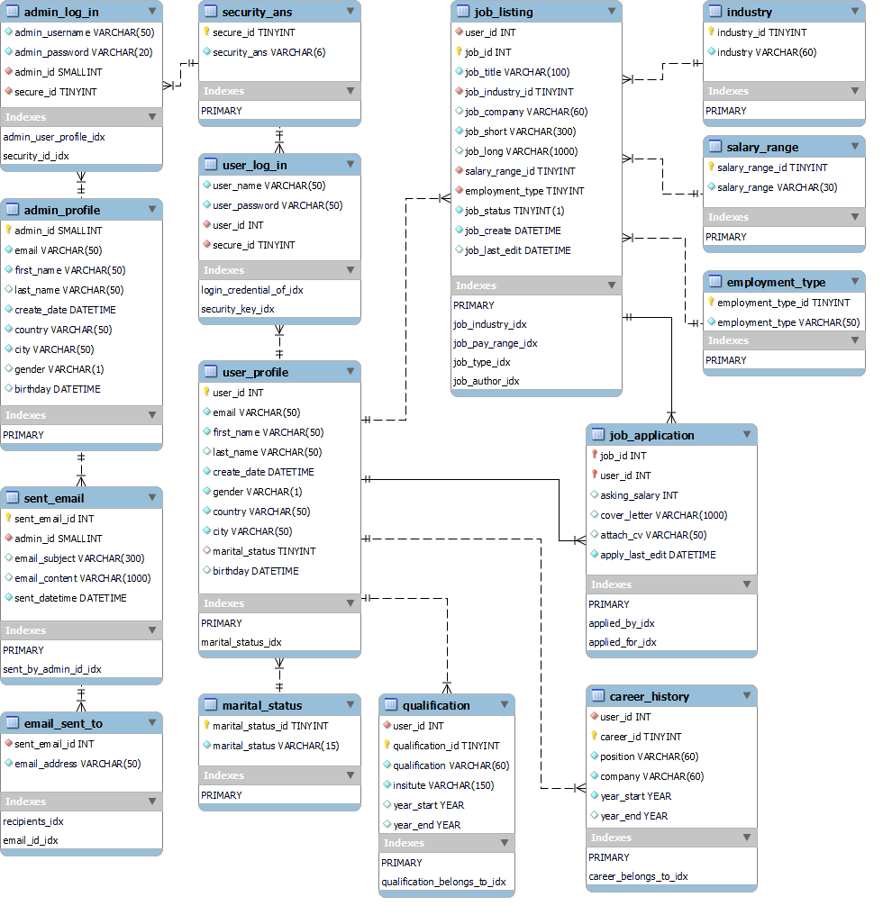
8. Primary Key, Foreign Key & Indexes

Slide 22
9. SQL Queries
Page | Table | Function | Query
Login | user_log_in | Validate login credential | SELECT user_name, user_password FROM user_log_in WHERE user_name=”user_input” AND user_password=”password_input”
Admin log in | admin_log_in | Validate login credential | SELECT admin_username, admin_password FROM admin_log_in WHERE admin_username=”user_input” AND admin_password=”password_input
Password reset | user_log_in | Change Password | UPDATE user_log_in SET user_password = “confirm_password' WHERE user_name = “user_input”;
Registration | user_profile | User Registration | INSERT INTO user_profile (email, user_pass, first_name, last_name, birthday, gender, country, state, city, bulk_email ) VALUES (“email_input’, ‘password_input’, ‘first_name, ‘last_name’, ‘birthday’, ‘gender’, ‘country’, ‘state’, ‘city’, ‘bulk_email’)
Search users | user_profile | Search for users by first name, last name, country, state or city | SELECT first_name, last_name, country, state, city FROM user_profile WHERE first_name=”search_input” OR last_name=”search_input” OR country=”search_input” OR city=”search_input”
List search results | user_profile | List users | SELECT first_name, last_name, country, state, city FROM user_profile WHERE first_name=”search_input” OR last_name=”search_input” OR country=”search_input” OR city=”search_input”

Slide 23
10. Report Queries
S. No. | Purpose of Query | Query
1 | Sort Members by Country | CREATE OR REPLACE VIEW Members_Registration_by_Country as SELECT country as Country_of_Residences, first_name as First_Name, last_name as Last_Name FROM user_profile; SELECT * from Members_Registration_by_Country ORDER BY Country_of_Residences;
2 | Jobs that Companies are actively hiring | CREATE OR REPLACE VIEW Jobs_that_Companies_are_actively_hiring as SELECT job_title as Jobs_Title, job_company as Hiring_Company, job_create as Jobs_Created_Date, job_status as Active_Boolean FROM job_listing WHERE job_status=1 SELECT * FROM Jobs_that_Companies_are_actively_hiring ORDER BY Jobs_Created_Date;

Slide 24
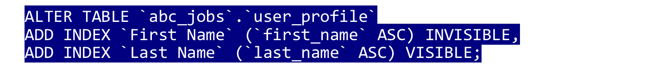
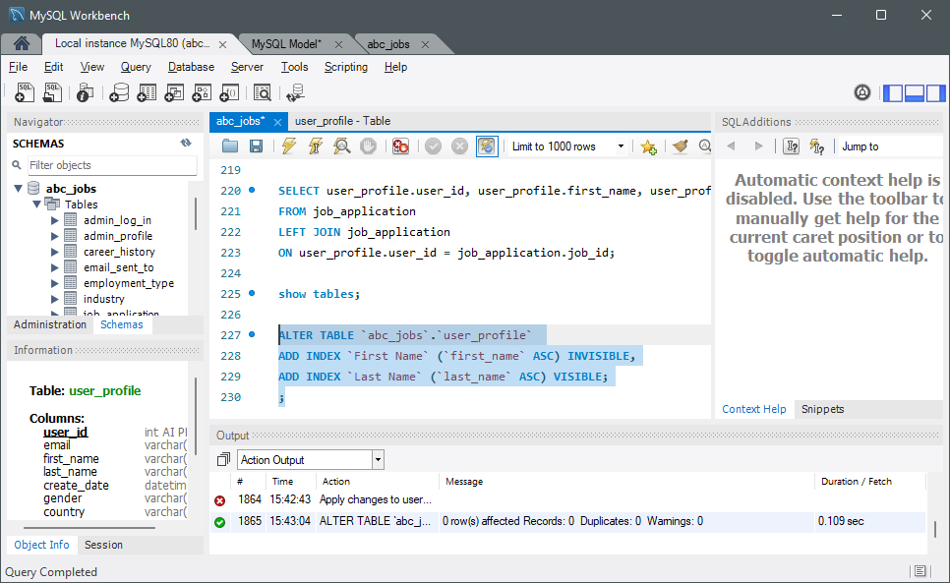
11. Indexes

Slide 25
12. Backup Script
mysqldump --user="admin" --password="password" --databases abc_jobs > D:\Desktop\sqlbackup\backup.sql

Slide 26
13. Project Milestones & Tasks
Project Task ID | Project Major Task Description | Project Milestone ID
1 | Setup the Development Environment based on the Technical Development Environment | 1
2 | Power point detailing the entities, tables and fields which need to created | 1
3 | Power point will also include Conceptual, Logical Design | 1
4 | Develop the Schema creation script or Implement using phpMyAdmin | 2
5 | Power point which Analyze and list the Queries which need to be created based on project requirements | 3
6 | Indexes & Backup Script | 3

Slide 27
14. Milestone Feedback & Action taken
Project Milestone ID | Milestone Feedback received from Tutor / Learning Facilitator | Action Taken (Yes / No)
1
2
3

Slide 28
15. Modifications Made based On Feedback

Slide 29
16. Project Results
List of Tables
  ……
  ……
  ……
  ……
  ……
  ……

Slide 30
17. Proposed Improvements
List of Improvements
  <List areas of improvement which you have identified after completion of the project>
  ……
  ……
  ……
  ……
  ……
  ……

